Slide 1

Palas Mall
Computer Network for Palas Mall
Students:
Puscasu Andrei
Paslariu Andrei-Nicolae
Coordinators:
dr.ing. Petre D. Matasaru

Slide 2
Activity Profile
Food Areas:
Restaurants
Cafes
Hypermarket
Pubs
Entertainment Areas:
Parks
Theater
Clubs
Congress Hall
Commercial Areas:
Clothing/Shoe/Accessory Stores
Electronic Stores
Libraries
Car park with over 2500 parking spaces
Number of Employees: 8000

Slide 3
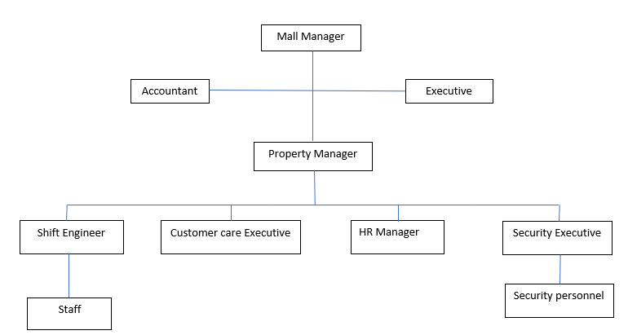

Organisation Structure

Slide 4
Benefits of public interest
Arrangement of a central underground parking with about 2500 parking places
Highlighting of discovered archaeological remains
A children's playground
An outdoor amphitheater
An outdoor ice rink
Restoration of the infrastructure in the area
A public garden
Preservation of the natural component of the area through the public garden and the green spaces within the complex

Slide 5
Social Benefits
Creation of over 3,000 temporary jobs during construction work
Creation of over 8,000 permanent jobs after inauguration
The decrease in the unemployment rate of Iasi
Capitalizing on the tourist potential of the city
Attracting new investors
Improving the degree of economic development of the area

Slide 6
Development Plans
An investment project of 335 million euros, meaning 1500 underground parking spaces and 10000 new jobs
Building a office tower behind Palas mall, proposed to be built on a high altitude on the site of the former Petrom which is situated on a medium height, the building will have a triangular shape, placed on the eastern side, near the playground area, there will be a underground building. Architects named it “Cinema Palas” but it will most likely be a multifunctional area.
An expansion of the Palas garden in 2 zones: towards the Luceafarul Theater and towards the former Petrom. E.ON will be demolished and Palas will have a small extension containing small spaces.
Saints Andrew’s area will be open to the public with market areas, green spaces, restaurants, cafes and pedestrian areas.

Slide 7
Network Connectivity
Individual local servers for remote CCTV monitoring and storage.
Secured local networks for businesses.
Publicly available internet hotspots for employees and customers.
Security cameras placed throughout the mall connected to a main server owned by the mall.

Slide 8
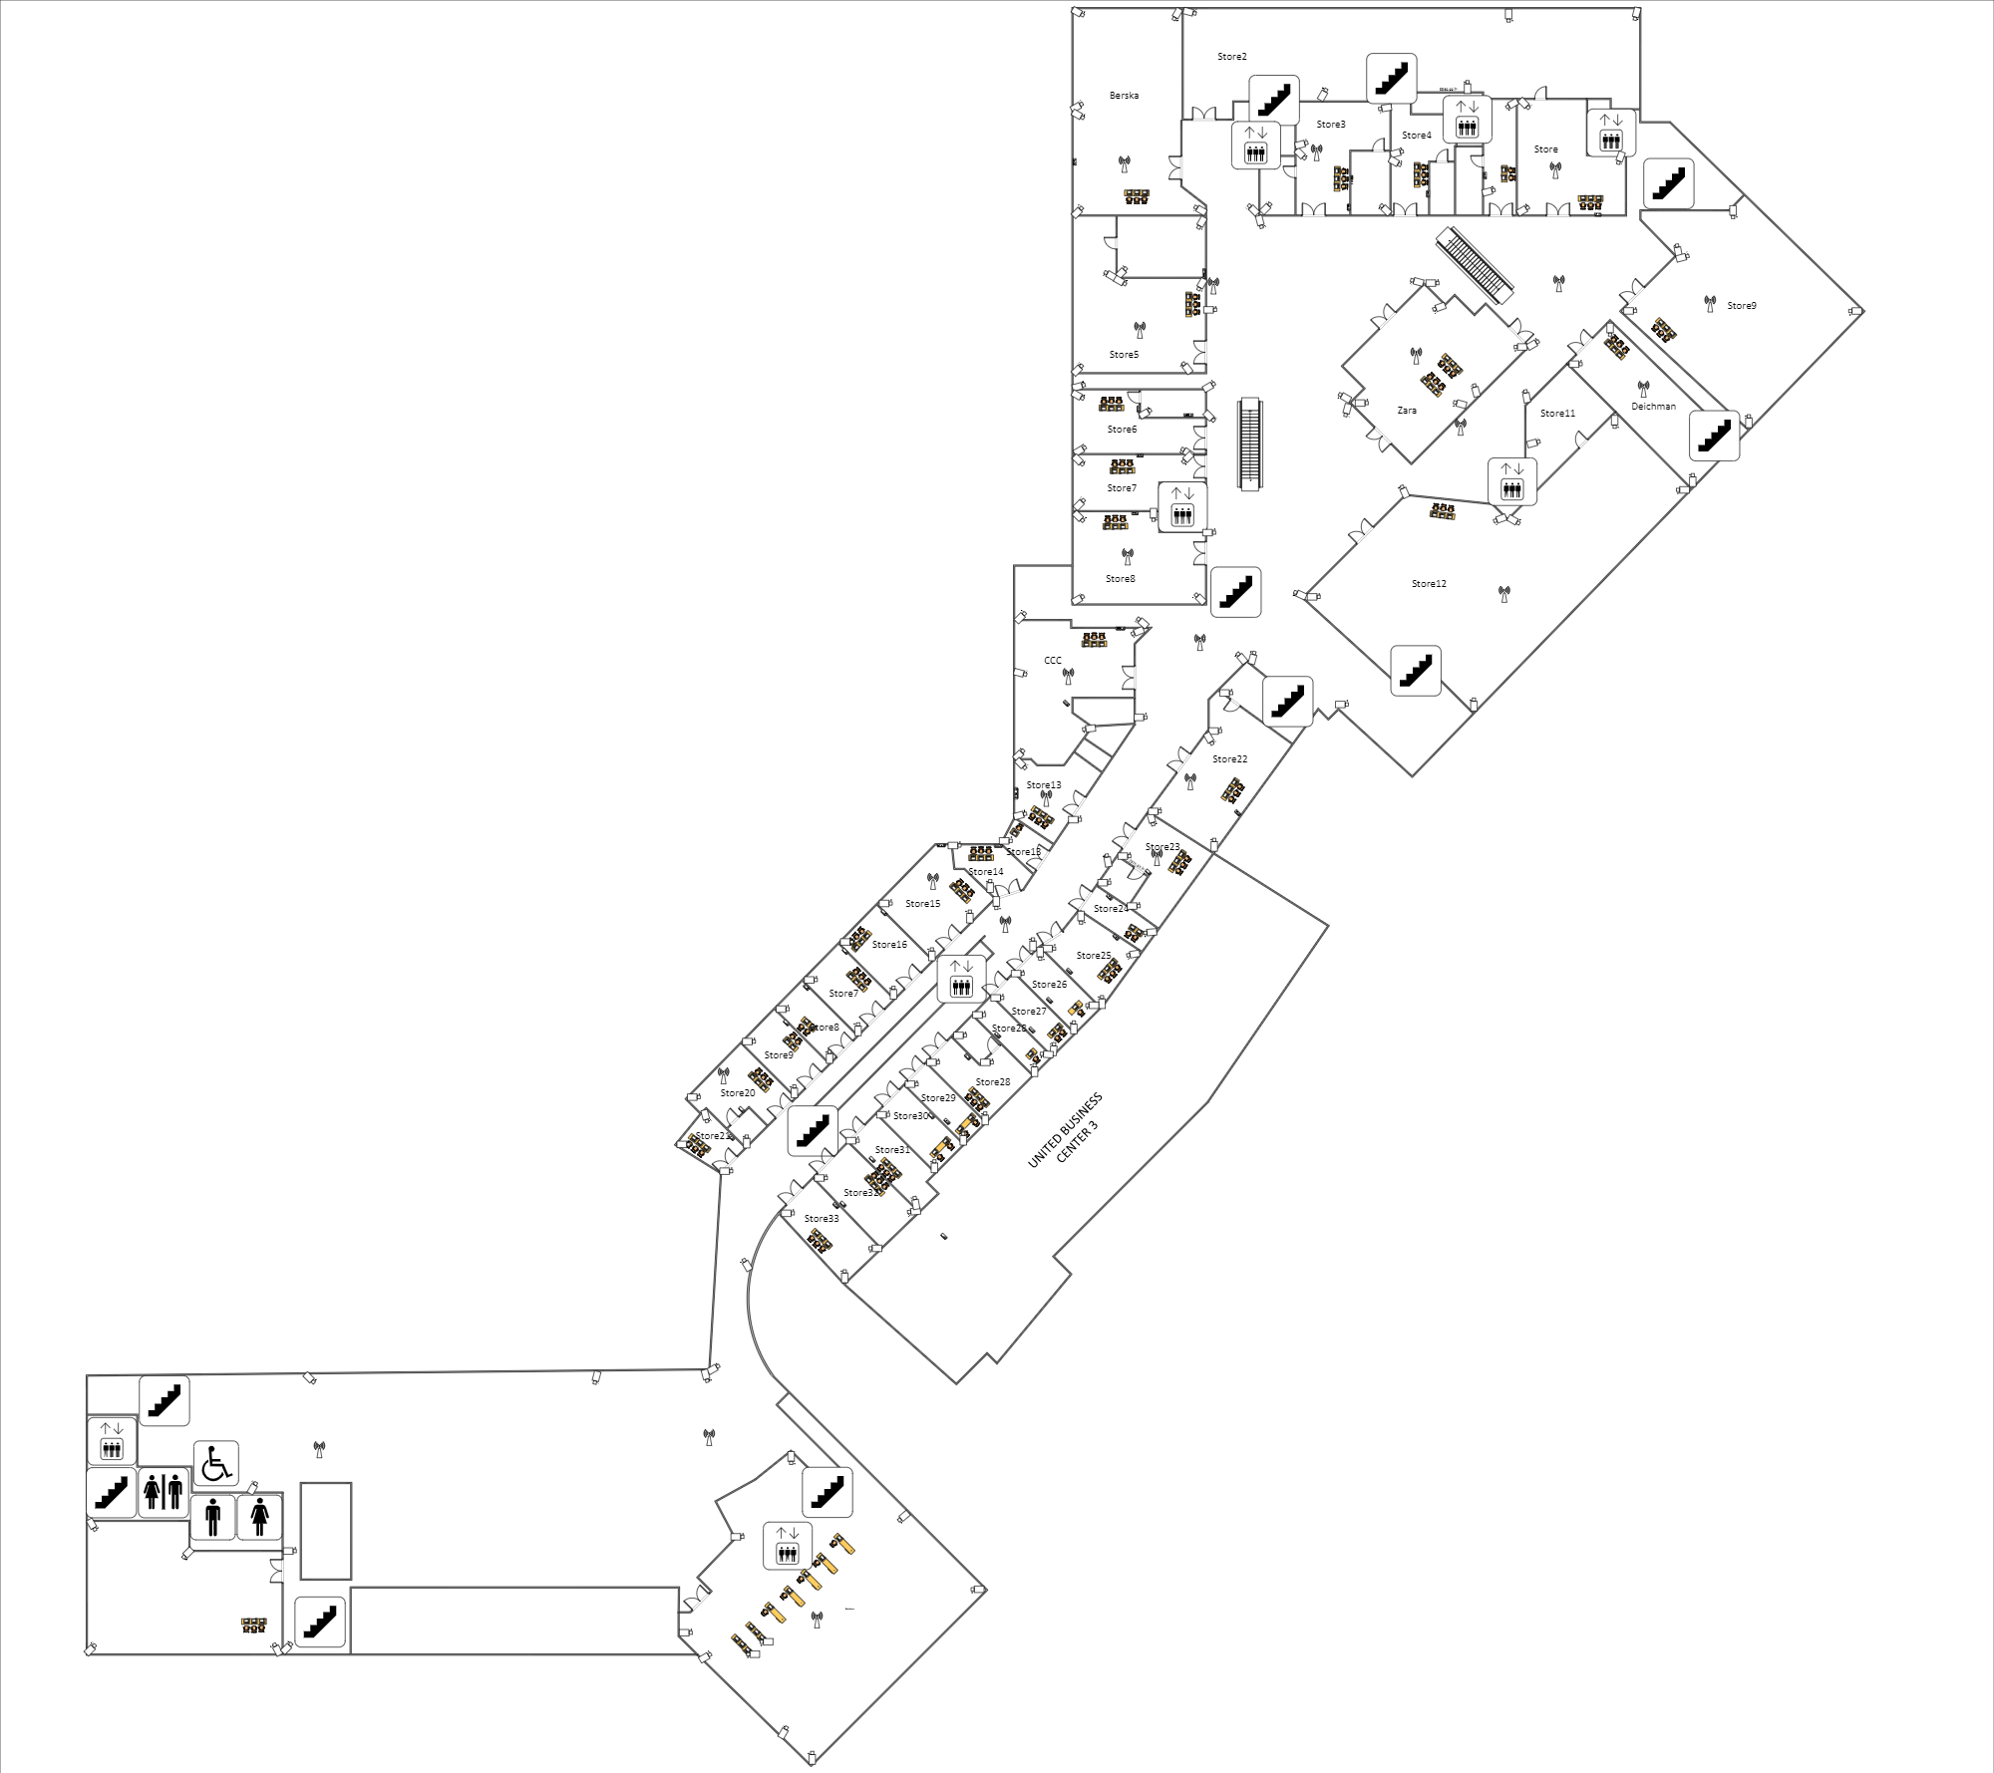
Space sketch of first floor

Slide 9
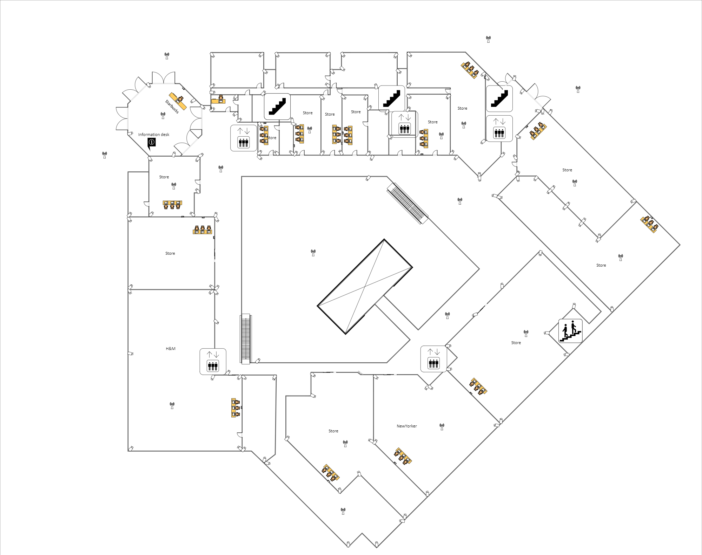
Space sketch of second floor

Slide 10
IP Address Analysis
How many physical subnets are needed today?
52 subnets
How many physical subnets are expected to be needed in the near future?
12 subnets
How many hosts must have the largest subnet today?
200 hosts
How many hosts must have the largest subnet in the near future?
200 hosts
To which address classes does the IP address belong?
class B
64 subnetworks, 1022 hosts/subnetwork
Network adress class B: 168.177.0.0
Subnetwork mask: 255.255.252.0
CIDR: /22 -> 16+6

Slide 11
Network connectivity
Subnetwork | IP Adress | Host Domanin | Broadcast Adress
#0 | 168.177.4.0 | 168.177.4.1-168.177.7.254 | 168.177.7.255
#1 | 168.177.8.0 | 168.177.8.1-168.177.11.254 | 168.177.11.255
#2 | 168.177.12.0 | 168.177.12.1-168.177.15.254 | 168.177.15.255
… | … | … | …
… | … | … | …
… | … | … | …
#35 | 168.177.140.0 | 168.177.140.1-168.177.143.254 | 168.177.143.255
#36 | 168.177.144.0 | 168.177.144.1-168.177.147.254 | 168.177.147.255
#37 | 168.177.148.0 | 168.177.148.1-168.177.151.254 | 168.177.151.255
… | … | … | …
… | … | … | …
… | … | … | …
#61 | 168.177.244.0 | 168.177.244.1-168.177.247.254 | 168.177.247.255
#62 | 168.177.248.0 | 168.177.248.1-168.177.251.254 | 168.177.247.255
#63 | 168.177.252.0 | 168.177.252.1-168.177.255.254 | 168.177.255.255

Slide 12
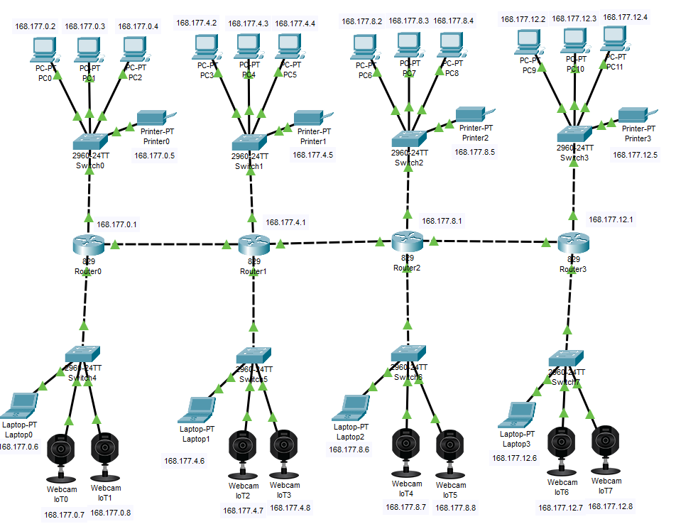
Cisco packet tracer layout example for 4 different networks

Slide 13
Equipment | Units | Price(RON) | Total Price(RON)
Server Dell PowerEdge T30, Intel Xeon E3-1225, 3.3Ghz, 8GB DDR4, 1TB, DVD-RW | 10 | 2100 | 21000
All-In-One System Lenovo IdeaCentre A340-22IWL, 22 inch FHD, Procesor Intel® Core™ i3-10110U 2.1GHz Comet Lake, 4GB DDR4, 1TB HDD + 128GB SSD | 300 | 2500 | 750000
Wireless router MikroTik Gigabit CRS125-24G-1S-2Hn | 12 | 960 | 11520
Switch TP-LINK Gigabit TL-SG1016DE | 52 | 338 | 17576
Network cable Hikvision Rola Cablu CAT.5e U/UTP 305m | 30 | 363 | 10890
RJ45 Jacks | 1500 | 0.28 | 420
Surveillance camera Dome Hikvision DS-2CE56H0T-VPITF Full HD | 300 | 200 | 60000
Surveillance Camera IP TRENDnet TV-IP318PI 8MP 4K | 8 | 1000 | 8000
LED Samsung Smart TV 75RU7172 Seria RU7172 189cm | 5 | 4300 | 21500
LED Samsung Smart TV 43RU7092 Seria RU7092 108cm | 15 | 1300 | 19500
Notebook / Laptop Lenovo 15.6'' IdeaPad S145, FHD, Procesor Intel® Core™ i3-1005G1 (4M Cache, up to 3.40 GHz), 8GB DDR4, 512GB SSD, GMA UHD | 20 | 2000 | 40000
Cable tunnel with adhesive 20x10x2000 mm, white | 1800 | 3.75 | 6750
Call Center Headphones Plantronics BLACKWIRE 225 | 20 | 150 | 3000
TOTAL |  |  | 976,836 RON

Slide 14
Logistical costs
Equipment | Units | Price(RON) | Total price(RON)
Car(Duster comfort) | 2 | 70000 | 140000
Power Drill | 6 | 290 | 1740
Aluminium stairs 3x9 steps | 4 | 350 | 1400
Professional tool organiser with Keter 220232 Tools included | 4 | 2000 | 1000
Network tester | 3 | 450 | 1350
Total |  |  | 145,490
Human resources

Slide 15
Human resources
Employees | Count | Salary | CAS(25%) | Health Insurance(10%) | CAM(2.25%) | Net Salary(RON)
System Engineer | 1 | 14000 | 3500 | 1400 | 350 | 8750
Network Engineer | 5 | 10000 | 2500 | 1000 | 250 | 6250
Technician | 10 | 4500 | 1125 | 450 | 112 | 2813

Slide 16
MANUAL LABOUR
TOTAL EMPLOYEES 16:
1 System Engineer
5 Network Engineers
10 Technicians
Split into 3 teams working on both floors
Estimated time : 4 weeks
TOTAL EQUIPMENT PRICE | 976,836 RON
TOTAL LOGISTICAL PRICE | 245,490 RON
HUMAN RESOURCES TOTAL LABOR PRICE | 109,000 RON
PROFIT(20%) | 266,265 RON
TAXES(16%) | 42,602 RON
TOTAL COST | 1,373,928 RON

